Slide 1
Firmware and below-the-OS security
Vincent Zimmer
These slides do not represent opinions of my employer. Past, present or future

Slide 2
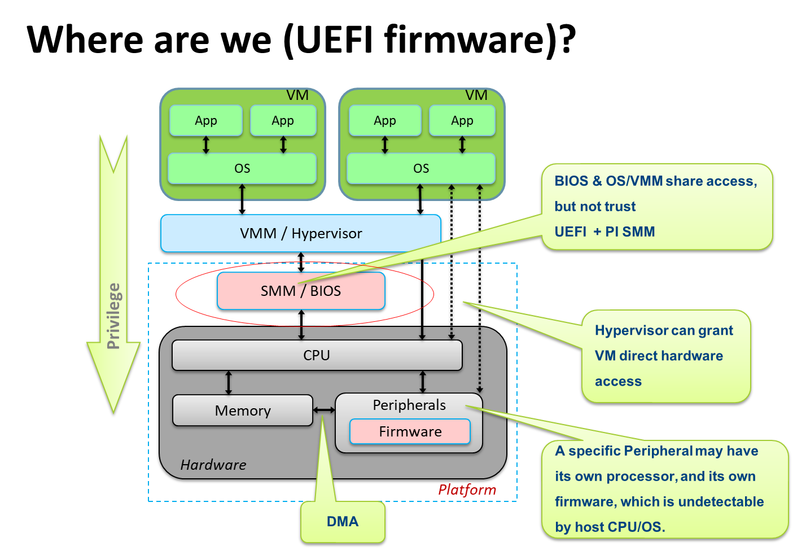

Slide 3
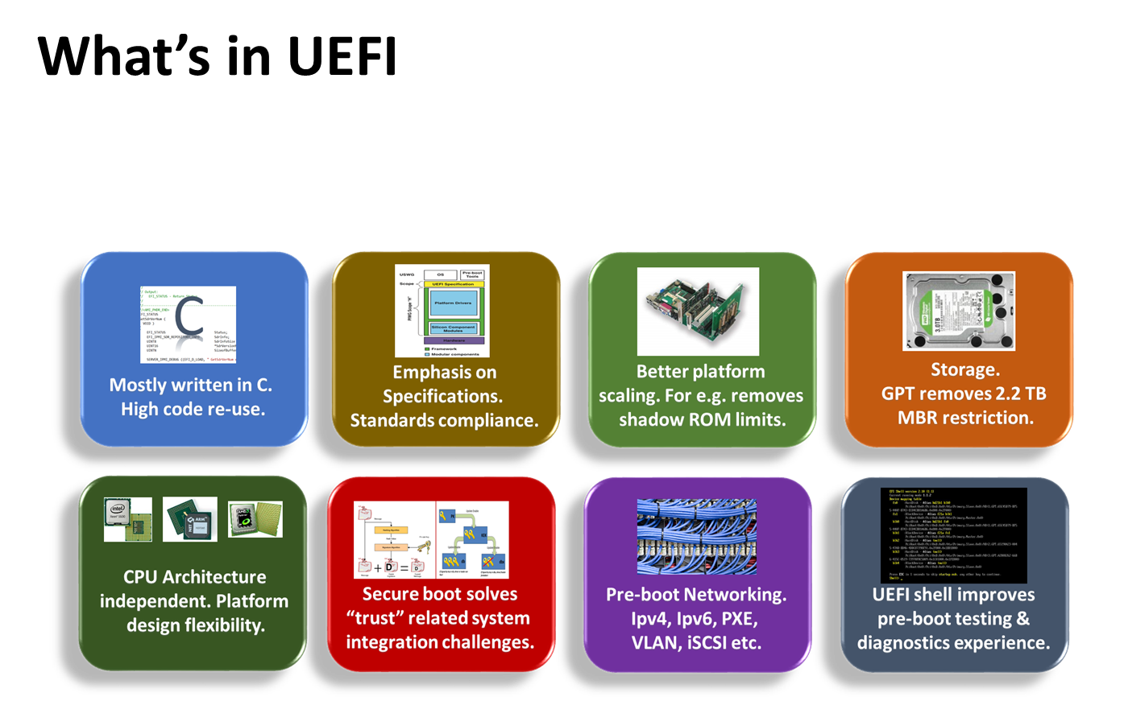

Slide 4
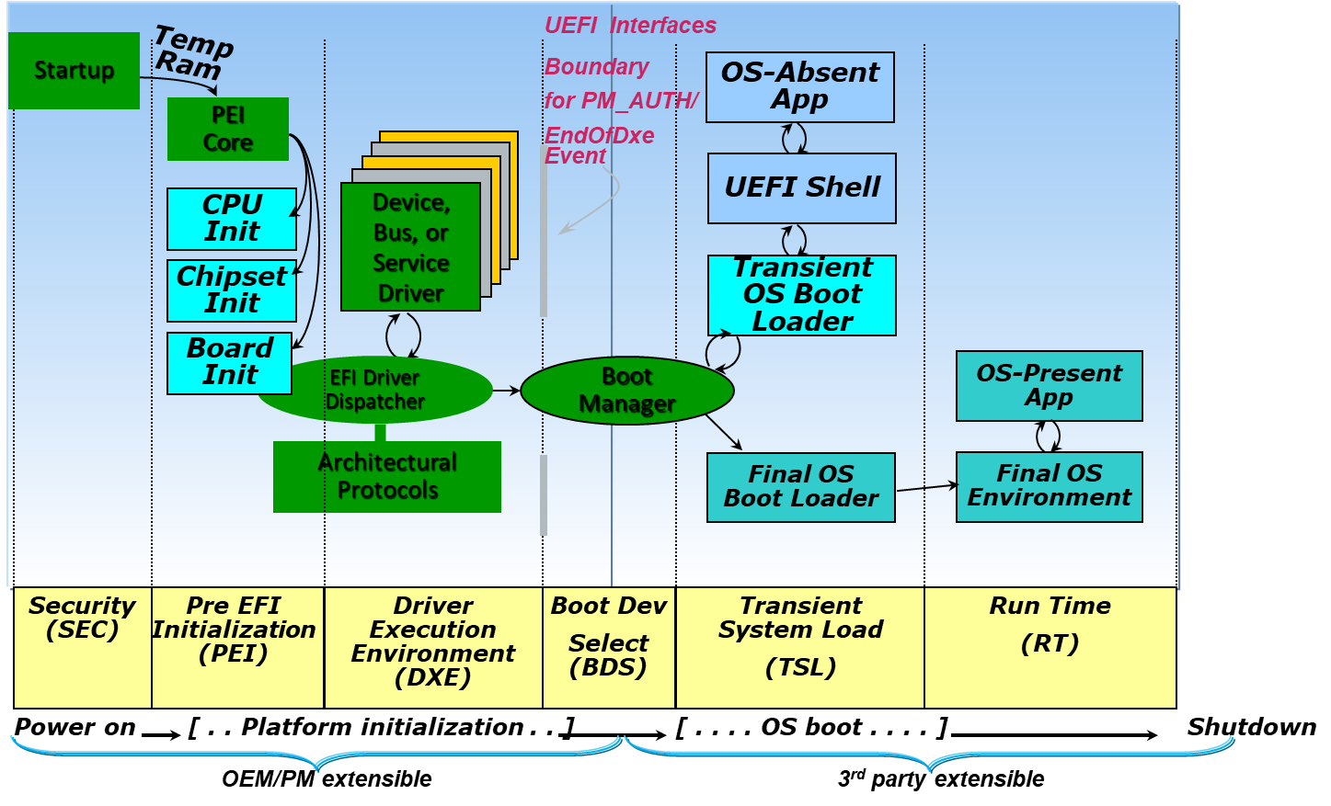
UEFI boot flow

Slide 5
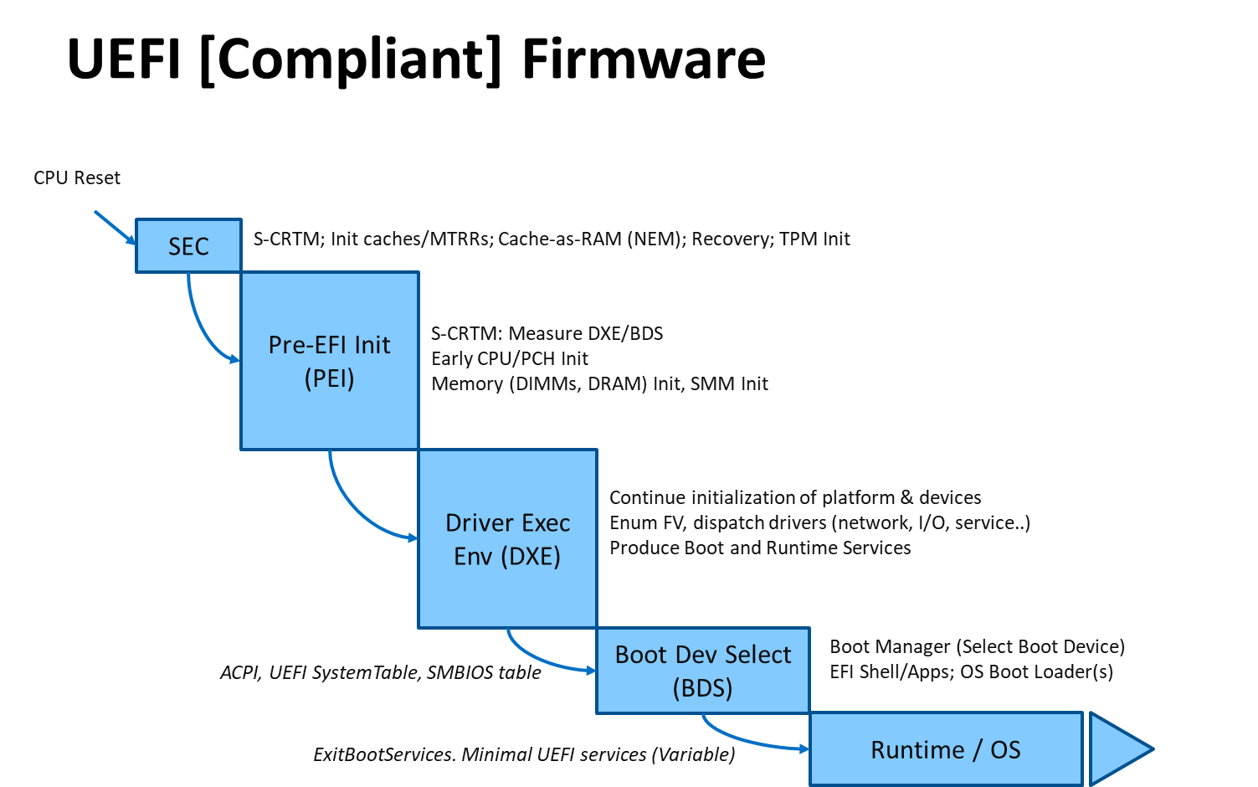

Slide 6
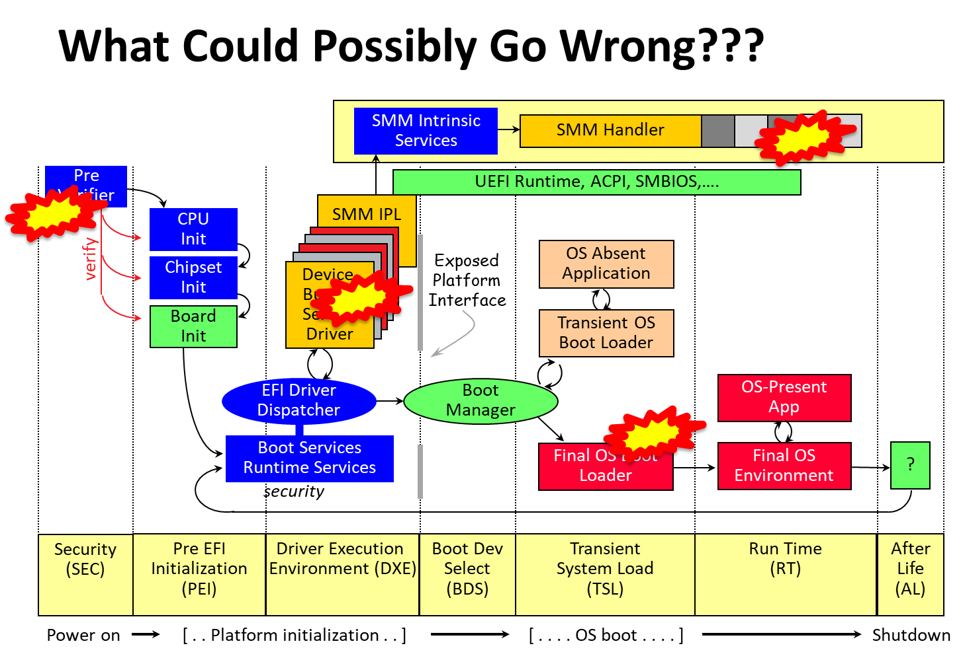

Slide 7
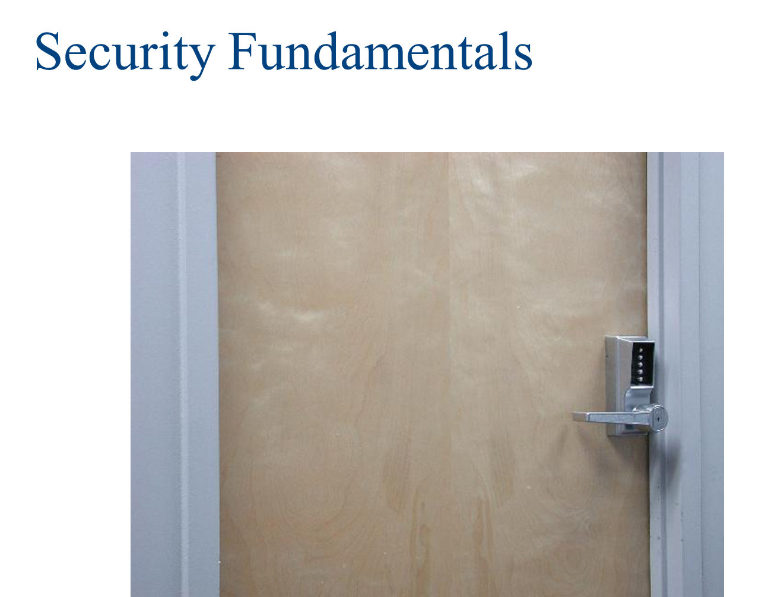

Slide 8
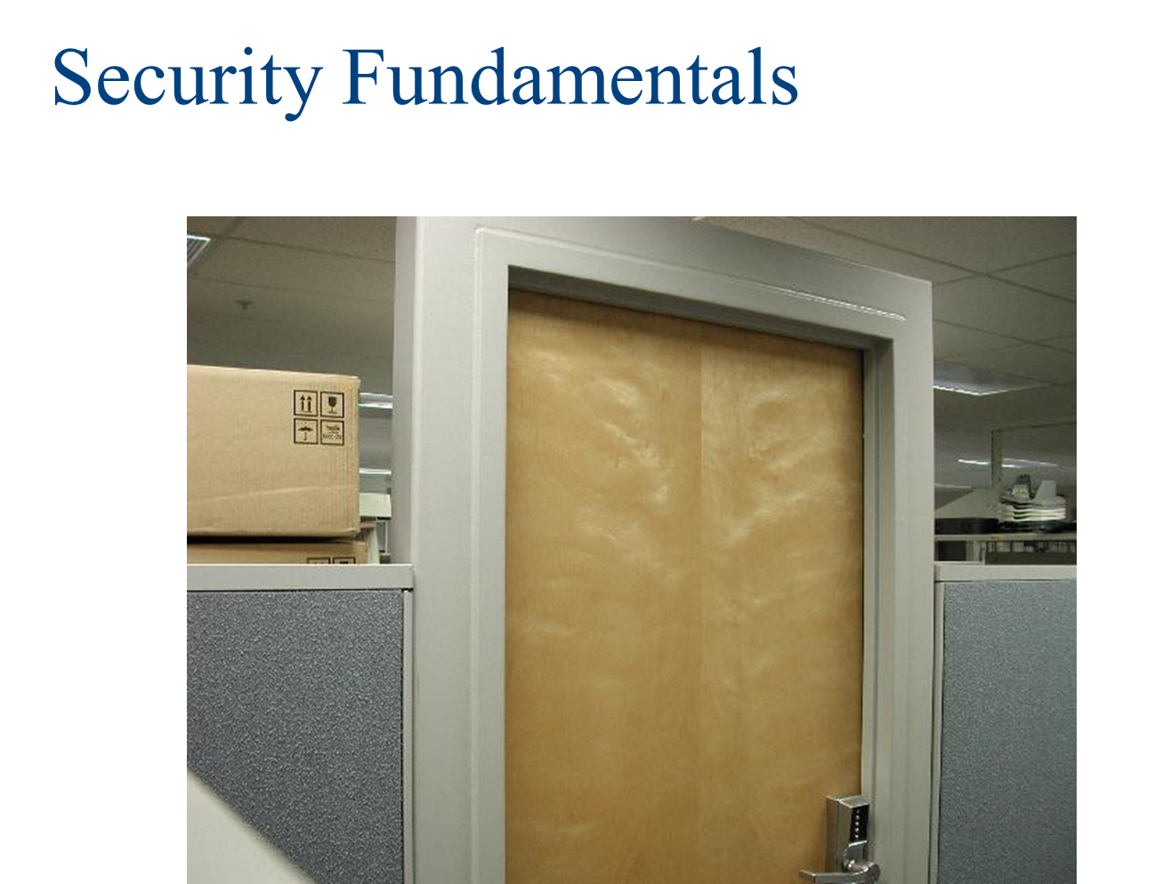

Slide 9
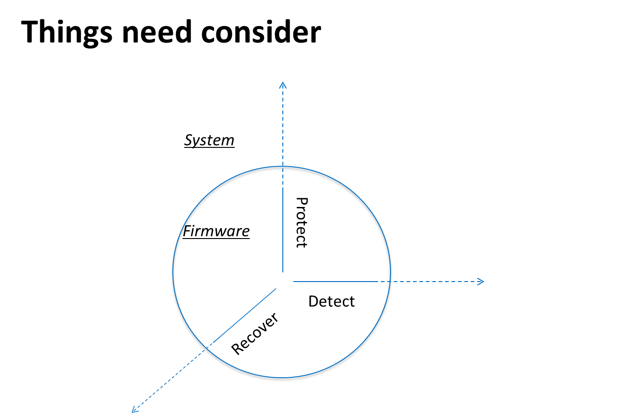

Slide 10
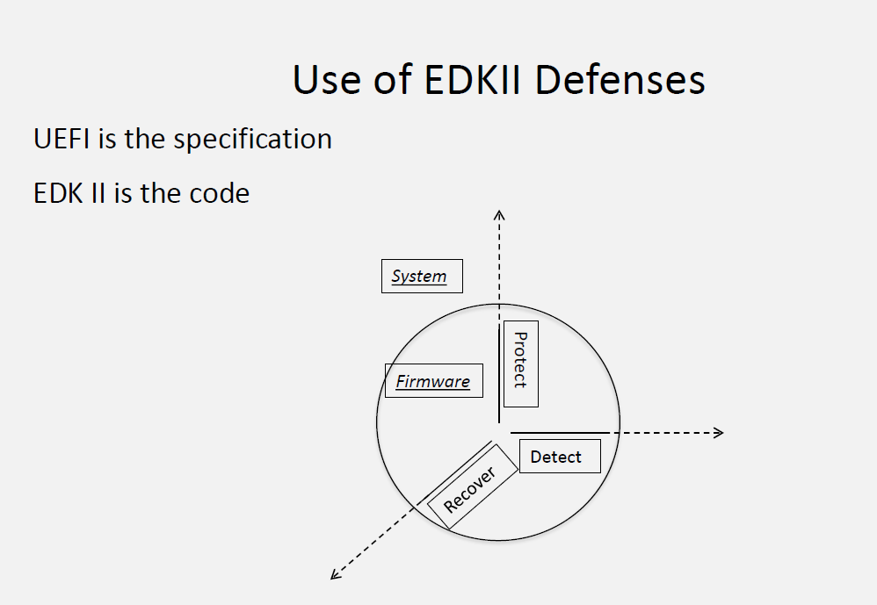

Slide 11
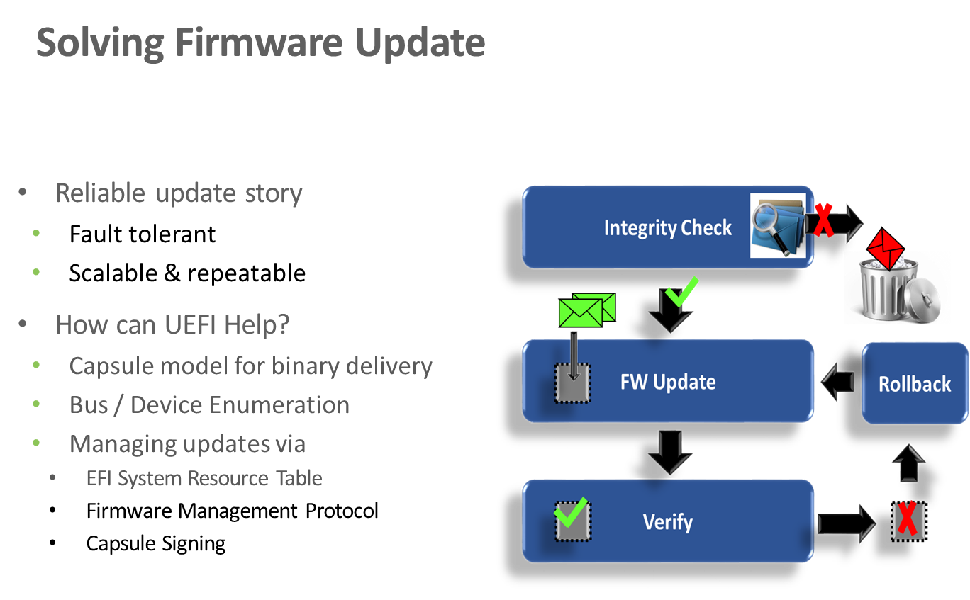

Slide 12
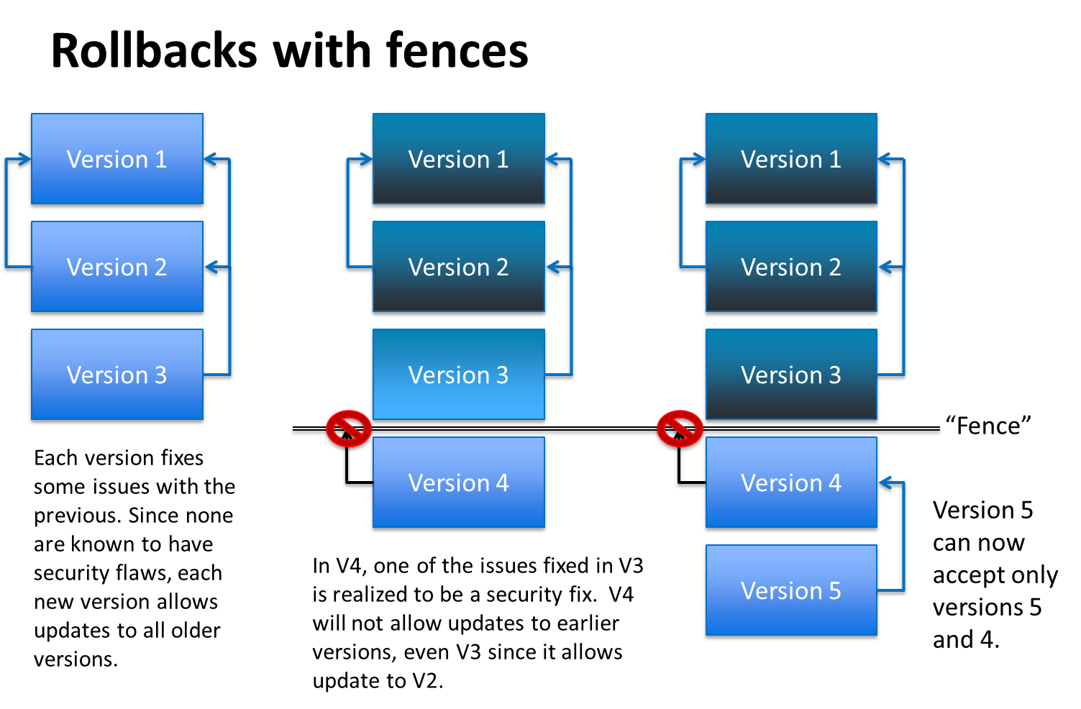

Slide 13
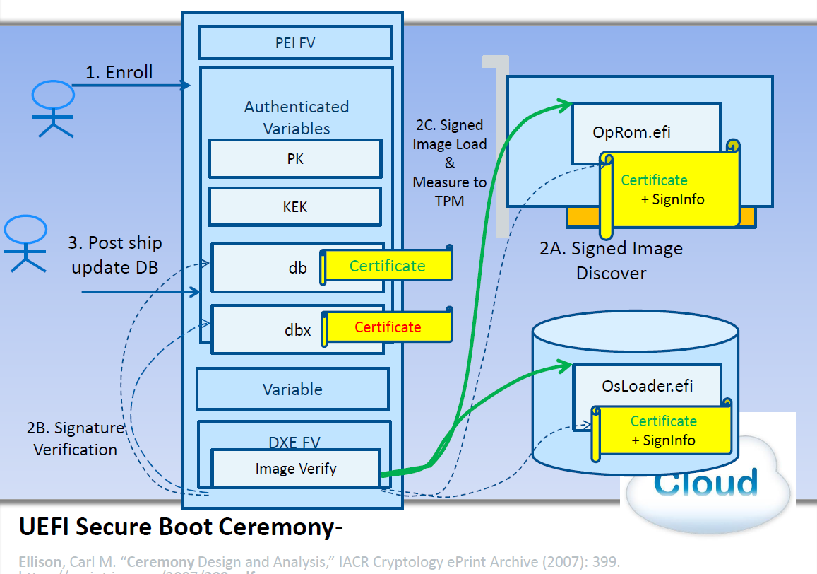

Slide 14
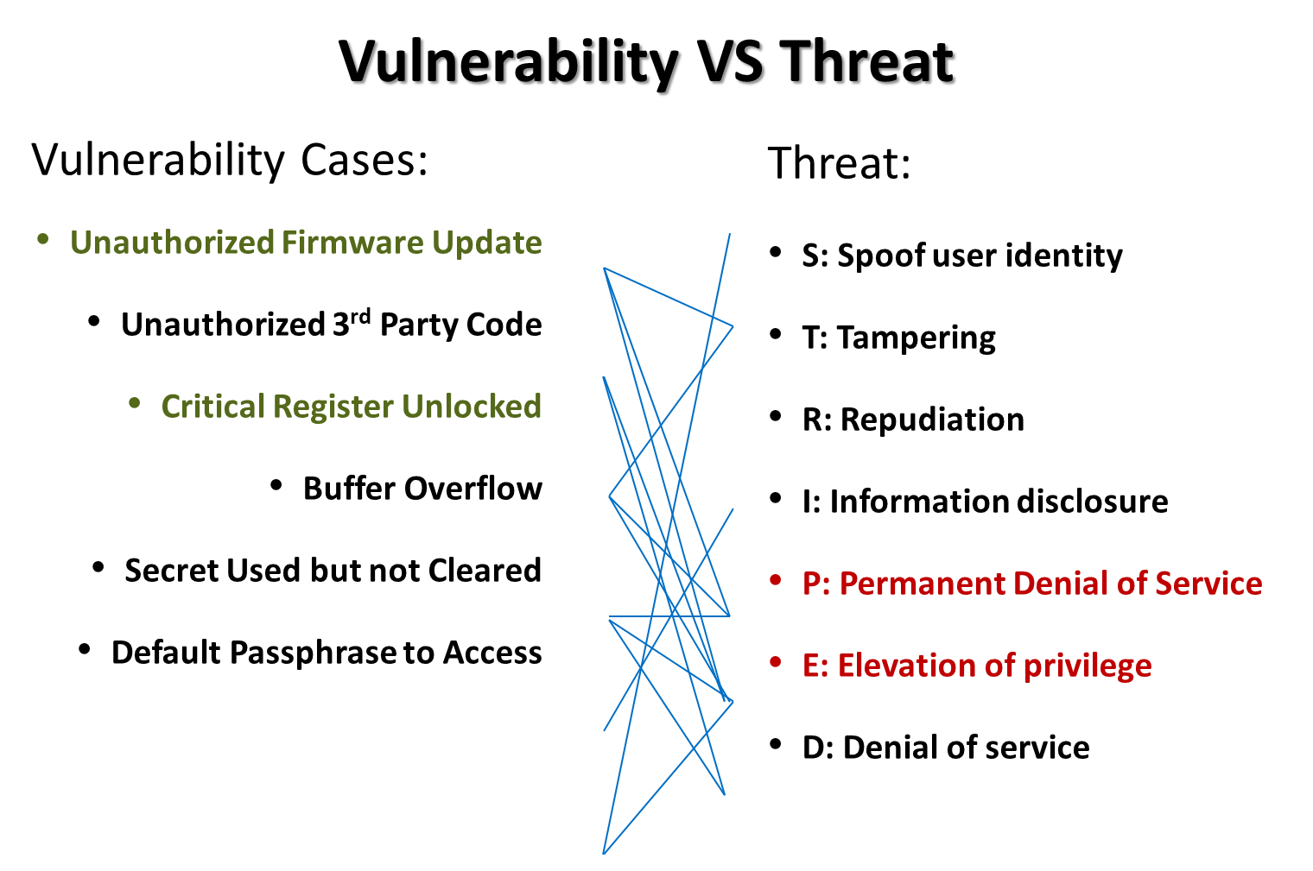

Slide 15
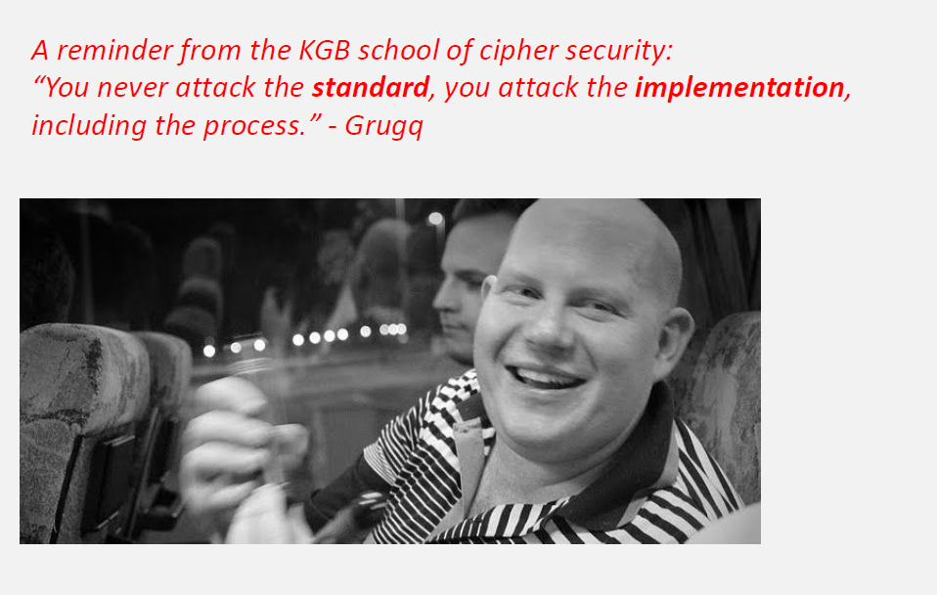

Slide 16
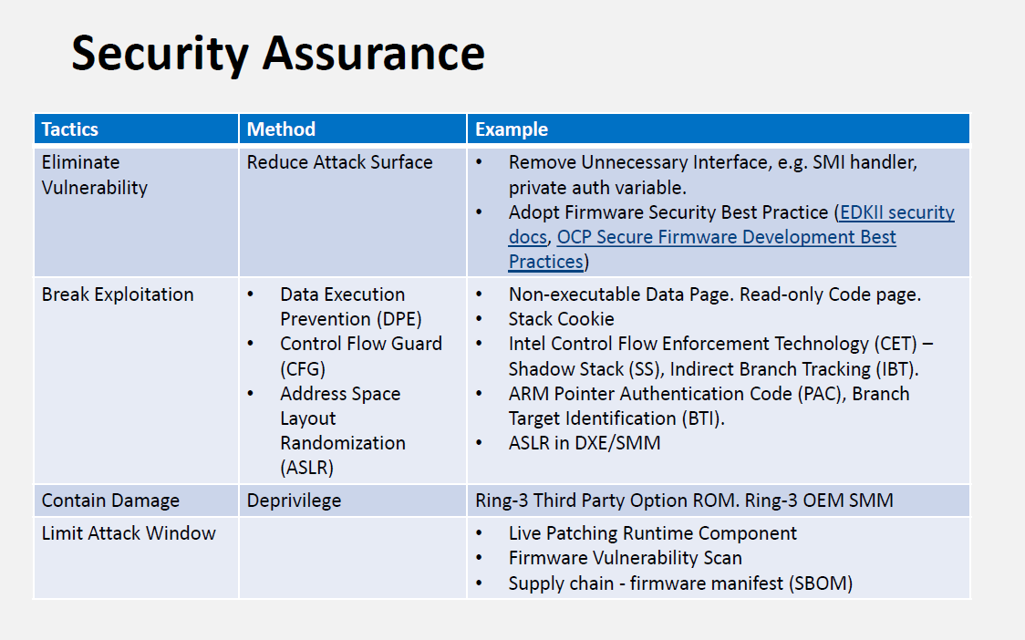

Slide 17
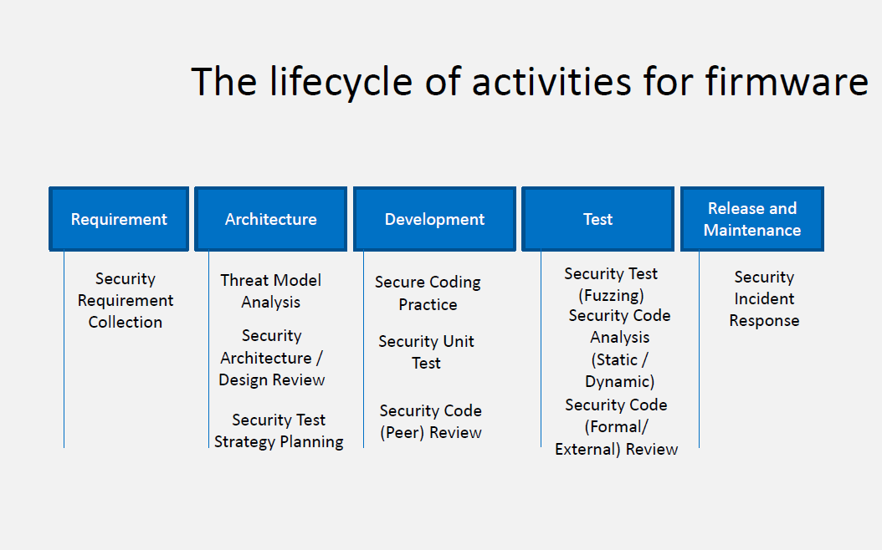

Slide 18
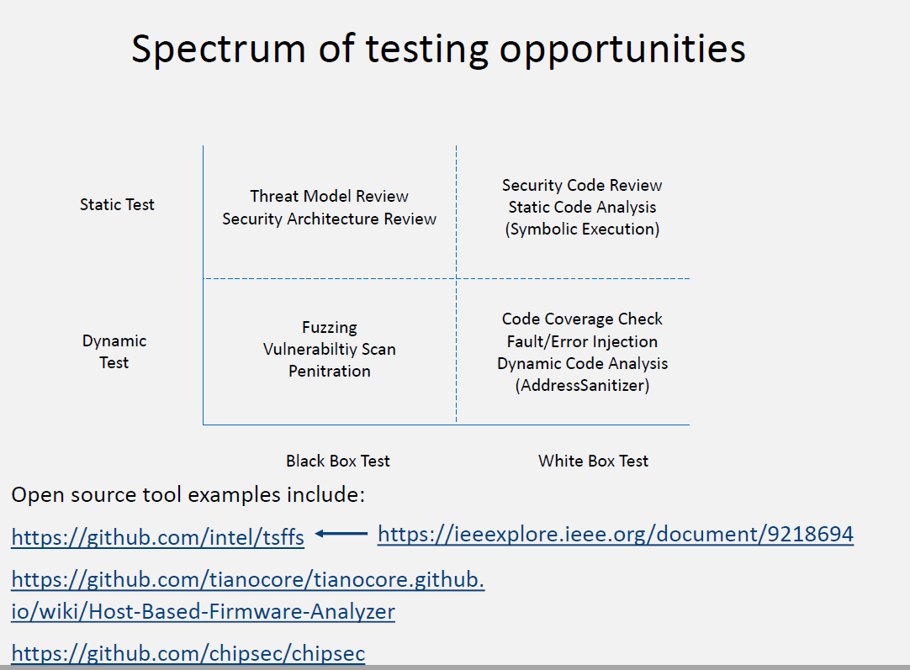

Slide 19
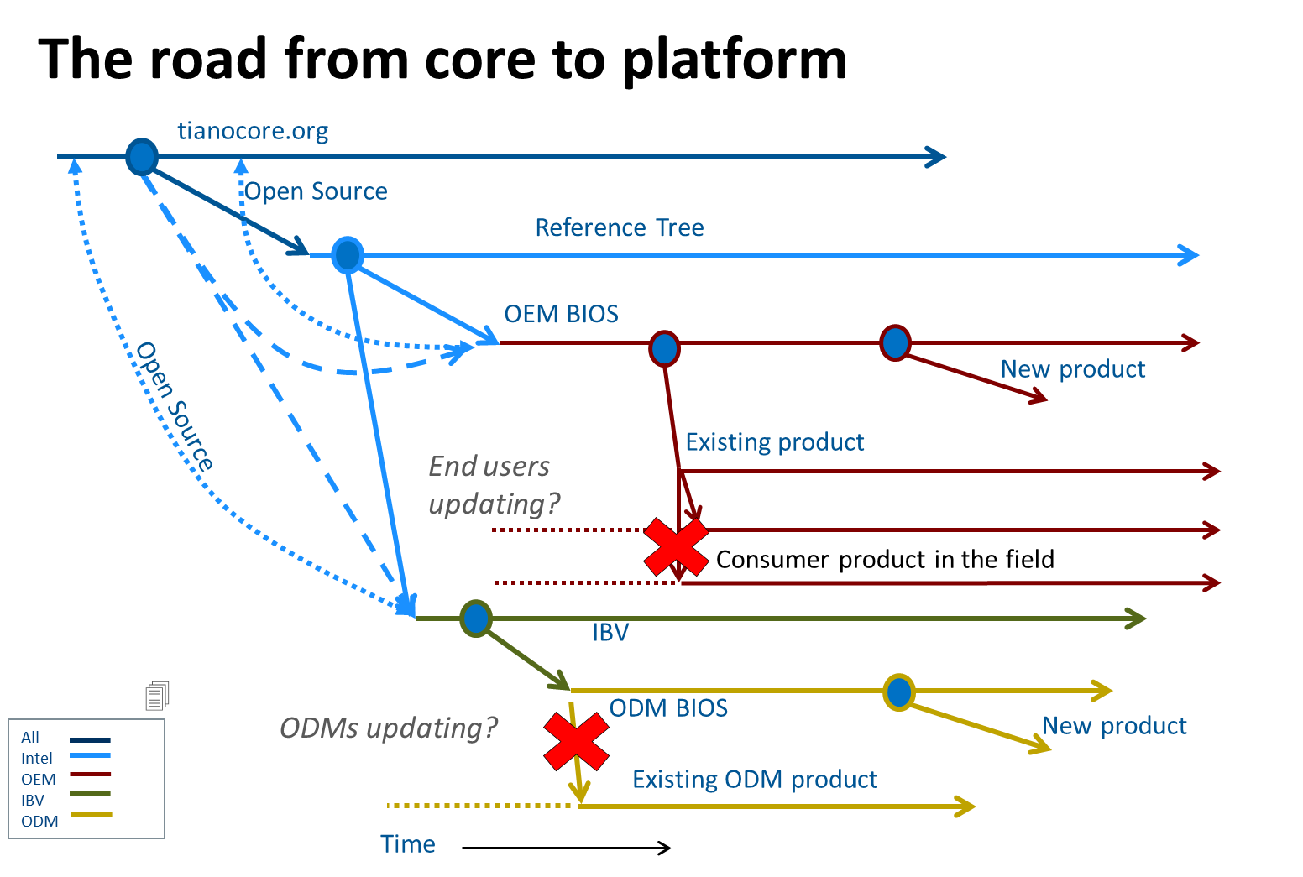

Slide 20
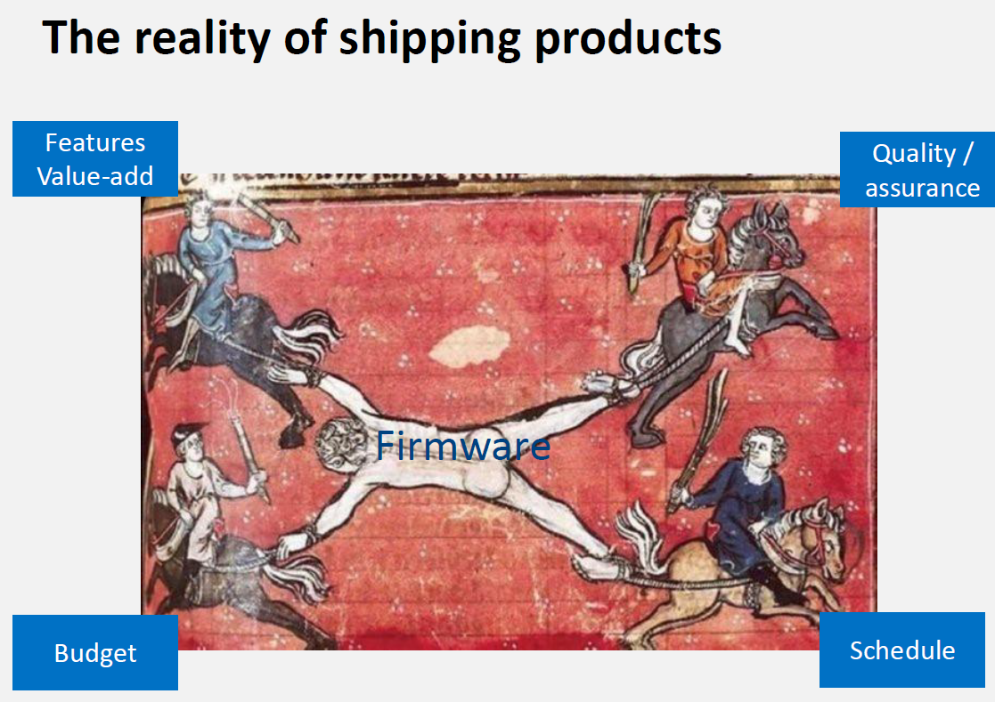

Slide 21
The value of open source
Upstream is Tianocore/EDKII. Project Mu is a downstream fork
https://github.com/microsoft/mu_basecore - basic UEFI & PI
https://github.com/microsoft/mu_tiano_plus - Security
https://github.com/microsoft/mu_feature_mm_supv - SMM supervisor
Important features include:
TPM Measured boot, UEFI Security Boot, Capsule Update, HTTP-S boot
Then build into ‘open platform’ (PSP/OpenSIL, ATF, FSP, coreboot+payload)

Slide 22
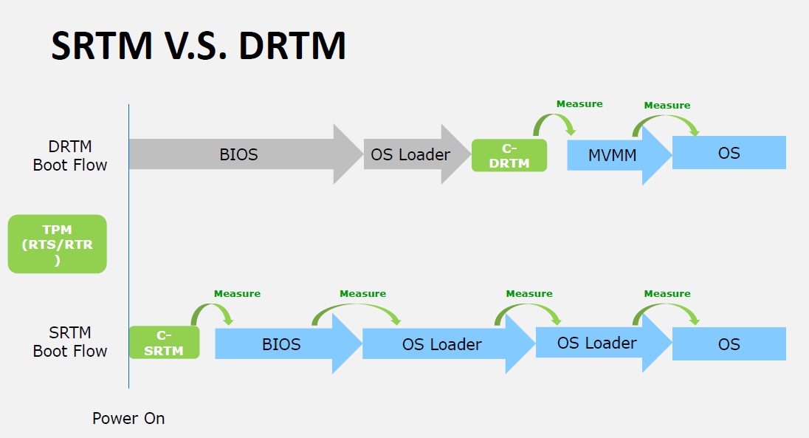
Trends

Slide 23
More trends
Language-based security - Rust

Slide 24
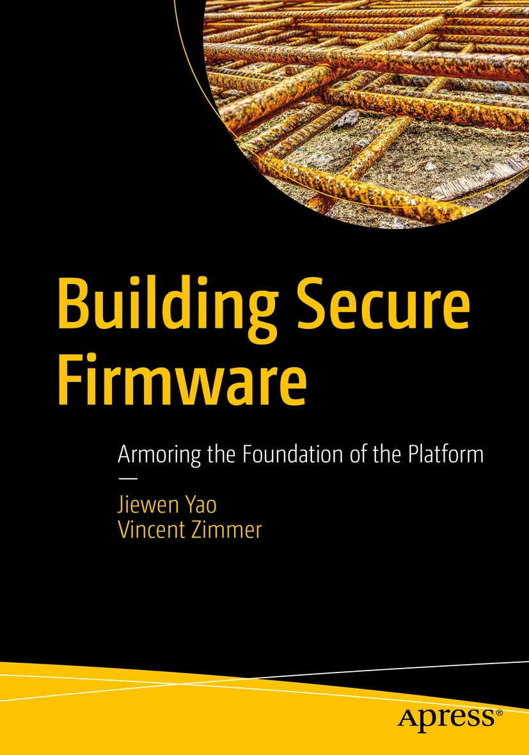
More information
EDKII white papers https://github.com/tianocore/tianocore.github.io/wiki/EDK-II-Security-White-Papers
Firmware Book
https://link.springer.com/book/10.1007/978-1-4842-6106-4

